Slide 1
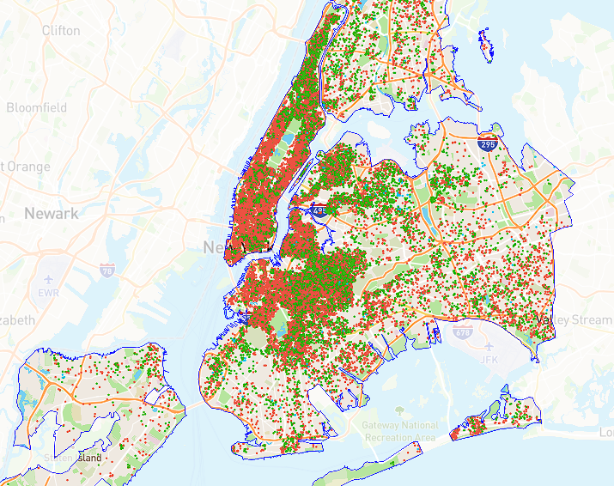
Predicting Short-term Rental Prices
Springboard – Capstone 2
Nizar Altawam
2023

Slide 2
Executive Summary
Setting the right prices for Short-term rentals is a key factor in maximizing profitability
This process can pose a challenge for new units entering the market with no pricing history to rely on.
Our machine learning approach utilizes the attributes of the unit itself to set an accurate price before the rental is placed on the market.
This resulted in a 1.4% increase in revenue over and above a naive model doing the same job.

Slide 3

Defining Short-term Rentals (STRs)
STRs are a type of accommodation that allows travelers to rent a property for a short period of time, usually less than a month.
They have become increasingly popular in recent years, especially in urban areas like New York City (NYC), where they offer an alternative to hotels and other traditional lodging options.
However, STRs also pose various challenges for the hosts, guests, and regulators, such as pricing, quality, safety, and legality.

Slide 4
Project Context and Motivation
Provide consulting services for a start-up company that operates in the NYC market.
It is seeking help optimizing its pricing strategy on its platform and increasing its revenue and market share
The aim is to build a machine learning prediction model for STR prices

Slide 5
Objectives and Scope
Using historical data on short-term listings scraped from Airbnb's website to:
Train a predictive model using important features
Conduct a profitability analysis to draw actionable insights
Identify key insights and highlight significant trends

Slide 6
Data Collection and Wrangling
Source: InsideAirbnb.com - A website that collects and publishes historical Airbnb listing data.
License: CC BY 4.0
The data covers a 12-month period (ending December 4th, 2022).
Three separate datasets were obtained:
“listings.csv.gz” - Detailed Listings data
“calendar.csv.gz” - Detailed Calendar Data
“listings.csv” - Summary information and metrics for listings in New York City.
Wrangling: dropped missing/incorrect values, outliers, and irrelevant features

Slide 7
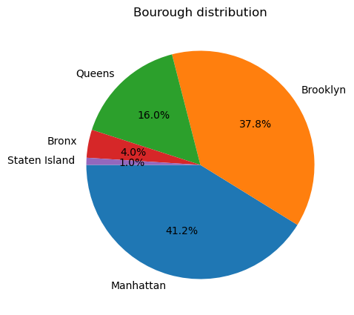
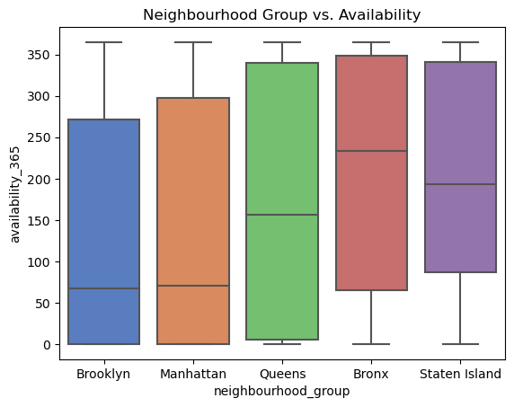
Exploratory Data Analysis
Data distribution analysis: examined the distribution of key features and their relationship with other features
Correlation analysis: performed correlation analysis to examine the price distribution across the boroughs and room types
Key findings: as follows…

Slide 8
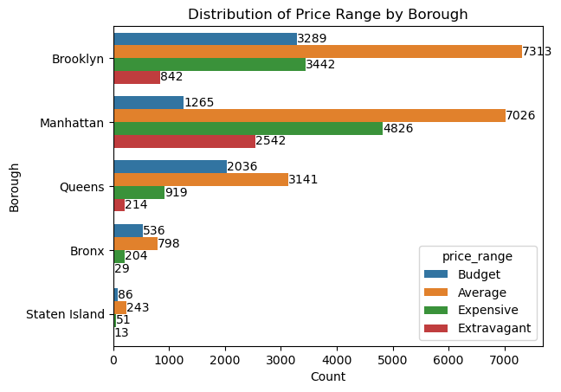
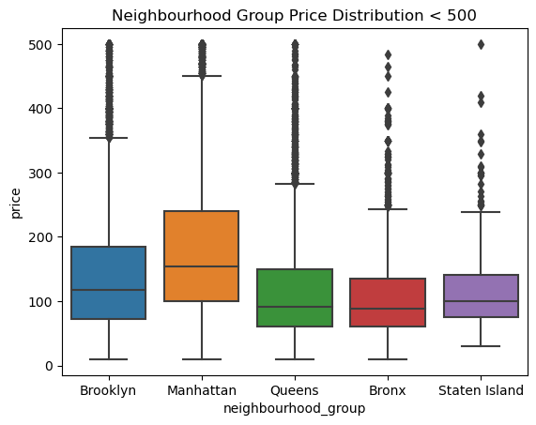
Key findings
1. Brooklyn and Manhattan had the largest share of listings (37.8% and 41.2%, respectively) and the highest median prices ($118 and $154, respectively)

Slide 9
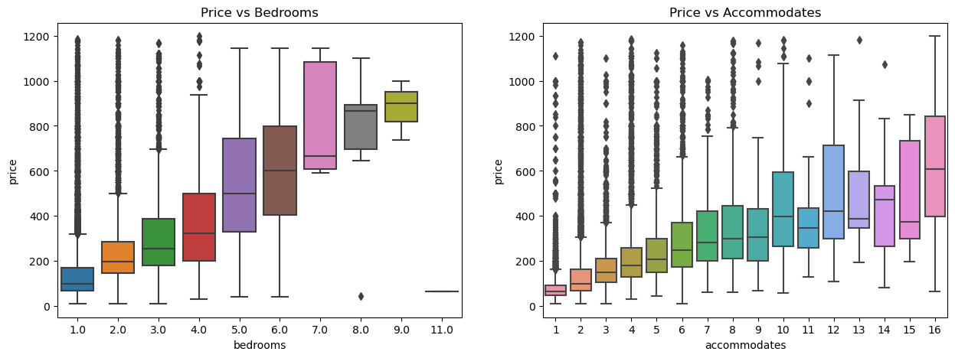
Key findings (cont.)
2. More bedrooms and guests accommodated were typically associated with higher prices

Slide 10
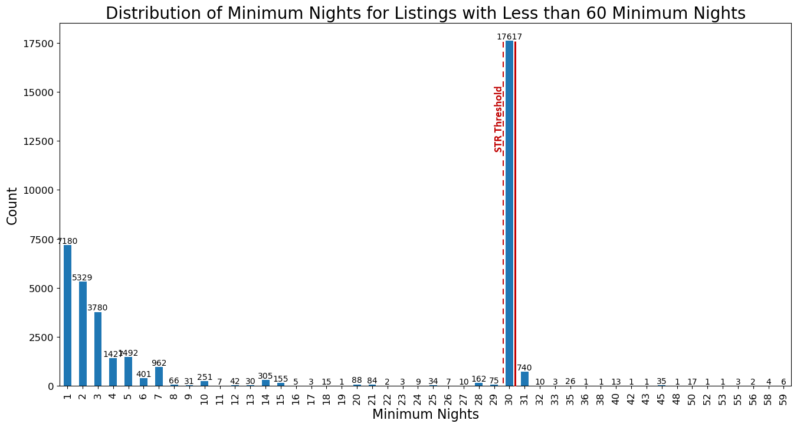
Key findings (cont.)
3. There was a significant number of longer-term stays (> 30 nights) possibly due to regulations or the recent pandemic
*note: Due to this imbalance in distribution, the definition of STR in the context of this project was redefined to include listings with less than 31 days

Slide 11
Data Pre-processing
Categorical feature encoding: encoded borough, neighborhood, and room_type features using one-hot and ordinal encoding
Data splitting: split the data into training and testing datasets with a 70/30 ratio
Baseline model: created a dummy model for comparison using the mean value of price as a constant prediction
Models: applied two machine learning algorithms:
Random Forest Regressor (RFR) and an XGBoost for Regression(XGBR).
Both models were tuned using grid search and cross validation to find the optimal hyperparameters.

Slide 12
Modeling
Evaluation metrics: used root mean squared error (RMSE) and mean absolute error (MAE) metrics to evaluate the performance of the models
The initial RFR model had an RMSE 111.6 with predictions being off by an average of $66.14.
Feature engineering:
In attempt to improve model performance, a new feature was created using the distance from a popular landmark within the same borough of each listing.

Slide 13
Performance Evaluation
Results:
> After adding the landmark proximity feature, the RFR performance improved to an RMSE of 108.4 and a prediction MAE of $64.75
> The XGB model was also retrained with the new feature and scored an RMSE of 105.7 and MAE of $63.45.
This slight improvement in performance compared to the RFR was noted, however running this model utilized more computational resources and took twice as long as the RFR needed to be trained.

Slide 14
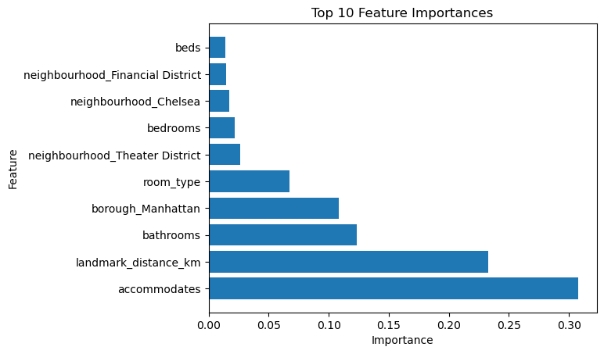
Feature Importance Analysis
Using RFR model for feature importance* to identify which features had the most influence on price:
Number of guests accommodated
number of bathrooms
distance from a popular landmark
*It's important to note that the importance score is a relative measure within the context of the specific model and dataset. It does not necessarily reflect the absolute importance of a feature or imply causality

Slide 15
Profitability Analysis
To understand the model’s performance and estimate potential revenue we conducted a hypothetical profitability analysis.
The analysis compared our model to a hypothetical model that takes the average price of listings aggregated by neighborhood and property type
Occupancy rate was estimated for each listing using availability information in the detailed calendar data. This was then factored into the revenue estimation.
The results indicate, for the listings assessed and over the 12-month period, our model would generate approximately a 1.4% increase in revenue.

Slide 16
Assumptions and Limitations
Data Limitations:
Does not capture complete population
Time range / potential variations in market dynamics
Feature Limitations:
Do not encompass all factors influencing price
Encoded categorical features
Model Limitations:
Assumptions and limitations associated with their specific algorithms
Performance may vary with new/unseen data
Business Context:
Analysis conducted within framework of the start-up company’s requirements
Profitability analysis conducted on a hypothetical model

Slide 17
Future Steps
Additional feature engineering: explore other features that may improve the prediction accuracy such as amenities, reviews, ratings, or sentiment analysis
Applying models on other cities: test the model on other cities with similar or different market conditions to evaluate its robustness and transferability
Using different models: try other machine learning algorithms or techniques such as neural networks, ensemble methods, or deep learning

Slide 18
Conclusion
This project presented a machine learning prediction model for short-term listing prices in New York City using historical Airbnb data
Two regression models were applied and tuned: Random Forest and XGboost. A new feature was also created using the distance from a popular landmark
The most important features for predicting price were guests accommodated, number of bathrooms, and proximity to a landmark
We discussed any assumptions & limitations that could affect the validity and reliability of the predictions in the project report..
Data was collected, wrangled, and analyzed to explore the distribution and correlation of price with various features

